Slide 1

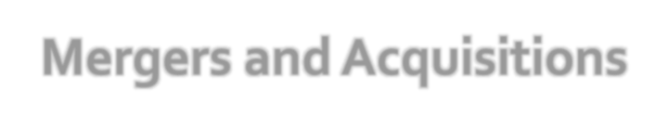

Presentation on:
CURRENT TRENDS IN MANAGEMENT
Mergers and Acquisitions
WEN ZHAOXIAN

Slide 2
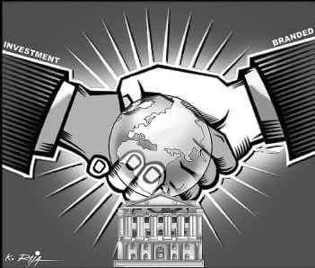
WHAT IS MERGER?
A merger is a combination of two or more companies where one corporation is completely absorbed by another corporation.
WHAT IS ACQUISITION?
Acquisition essentially means ‘to acquire’ or ‘to takeover’. Here a bigger company will take over the shares and assets of the smaller company.

Slide 3

The concept of merger and acquisition in India was not popular until the year 1988.
The key factor contributing to fewer companies involved in the merger is the regulatory and prohibitory provisions of MRTP Act, 1969. (Monopolies and Restrictive Trade Practices Act,1969)
The year 1988 witnessed one of the oldest business acquisitions or company mergers in India.
As for now the scenario has completely changed with increasing competition and globalization of business. It is believed that at present India has now emerged as one of the top countries entering into merger and acquisitions.

Slide 4










○ Preliminary Assessment or Business Valuation- In this process of assessment not only the current financial performance of the company is examined but also the estimated future market value is considered
Preliminary Assessment or Business Valuation
○ Phase of Proposal- After complete analysis and
review of the target firm's market performance, in the second step, the proposal for merger or acquisition is given.
○ Exit Plan- When a company decides to buy out the target
firm and the target firm agrees, then the latter involves
in Exit Planning.
Stage of Integration
Phase of Proposal
Structured Marketing- After finalizing the Exit Plan, the target firm involves in the marketing process and tries to achieve highest selling price.
Stage of Integration- In this final stage, the two firms are integrated through Merger or Acquisition.
Structured Marketing
Exit Plan

Slide 5

A horizontal merger - This kind of merger exists between two companies who compete in the same industry segment.
A vertical merger - Vertical merger is a kind in which two or more companies in the same industry but in different fields combine together in business.
Co-generic mergers - Co-generic merger is a kind in which two or more companies in association are some way or the other related to the production processes, business markets, or basic required technologies.
Conglomerate Mergers - Conglomerate merger is a kind of venture in which two or more companies belonging to different industrial sectors combine their operations.

Slide 6

Friendly acquisition - Both the companies approve of
the acquisition under friendly terms.
Reverse acquisition - A private company takes over a public company.
Back flip acquisition- A very rare case of acquisition in which, the purchasing company becomes a subsidiary of the purchased company.
Hostile acquisition - Here, as the name suggests, the
entire process is done by force.

Slide 7

ACQUISITION
MERGER
Buying one organization by another.
It can be friendly takeover or hostile takeover.
Acquisition is less expensive than merger.
Buyers cannot raise their enough capital.
It is faster and easier
transaction.
The acquirer does not experience the dilution of ownership.
Merging of two organization in
to one.
It is the mutual decision.
Merger is expensive than acquisition(higher legal cost).
Through merger shareholders can increase their net worth.
It is time consuming and the company has to maintain so much legal issues.
Dilution of ownership occurs in merger.
iii.
iii.

Slide 8
i. Increase Market Share.
WHY IS IMPORTANT
PROBLEM WITH MERGER
Clash of corporate cultures
Increased business complexity
Employees may be resistant to change
Economies of scale
Profit for Research and development.
Benefits on account of tax shields like carried forward losses or unclaimed depreciation.
Reduction of competition.
8

Slide 9
i. Increased market share.
WHY IS IMPORTANT
PROBLEM WITH ACUIQISITION
Inadequate valuation of target.
Inability to achieve synergy.
Finance by taking huge debt.
Increased speed to market
Lower risk comparing to develop new products.
Increased diversification
Avoid excessive competition
iii.
9

Slide 10

M&A
Market-extension
merger
Product-extension merger
Conglomeration
Two companies that sell the same products in different markets
Two companies selling different but related products in the same market
Two companies that have no common business areas

Slide 11





Economies of large scale business
large-scale business organization enjoys
both internal and external economies.
Economies of large scale business
Elimination of
competition
Elimination of competition
It eliminates severe, intense and wasteful
expenditure by different competing organizations.
Desire to enjoy monopoly power
M&A leads to monopolistic control in the market.
Desire to enjoy
monopoly power
Adoption of modern technology
Adoption of modern technology
corporate organization requires large resources
Lack of technical and managerial talent
Lack of technical and managerial talent
Industrialization, scarcity of entrepreneurial,
managerial and technical talent

Slide 12
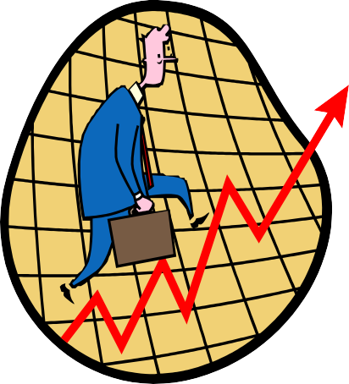
Greater Value Generation.
Mergers and acquisitions generally succeed in generating cost efficiency through the implementation of economies of scale. It is expected that the shareholder value of a firm after mergers or acquisitions.
Gaining Cost Efficiency.
When two companies come together by merger or acquisition, the joint company benefits in terms of cost efficiency. As the two firms form a new and bigger company, the production is done on a much larger scale.
Increase in market share - An increase in market share is one of the plausible benefits of mergers and acquisitions.
Gain higher competitiveness - The new firm is usually more cost-efficient and competitive as compared to its financially weak parent organization.

Slide 13

Integration difficulties
Large or extraordinary debt
Managers overly focused on acquisitions
Overly Diversified

Slide 14
○ Employees:
Mergers and acquisitions impact the employees or the workers the most. It is a well known fact that whenever there is a merger or an acquisition, there are bound to be lay offs.
○
Impact of mergers and acquisitions on top level management
Impact of mergers and acquisitions on top level management may actually involve a "clash of the egos". There might be variations in the cultures of the two organizations.
Shareholders of the acquired firm:
The shareholders of the acquired company benefit the most. The reason being, it is seen in majority of the cases that the acquiring company usually pays a little excess than it what should. Unless a man lives in a house he has recently bought, he will not be able to know its drawbacks.
Shareholders of the acquiring firm: hey are most affected. If we measure the benefits enjoyed by the shareholders of the acquired company in degrees, the degree to which they were benefited, by the same degree, these shareholders are harmed

Slide 15

Then there is an important need to assess the market by deciding the growth factors through future market opportunities, recent trends, and customer's feedback.
The integration process should be taken in line with consent of the management from both the companies venturing into the merger.
Restructuring plans and future parameters should be decided with exchange of information and knowledge from both ends.

Slide 16


Slide 17
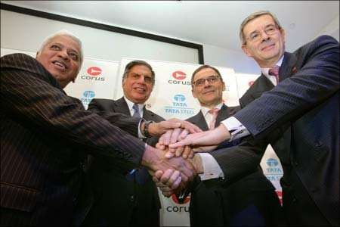
○ January 30, 2007
Largest Indian take-over
After the deal TATA’S became the 5th largest STEEL co.
100 % stake in CORUS paying Rs 428/- per share
Image: B Mutharaman, Tata Steel MD; Ratan
Tata, Tata chairman; J Leng, Corus chair;
and P Varin, Corus CEO.

Slide 18
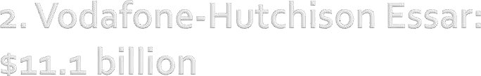
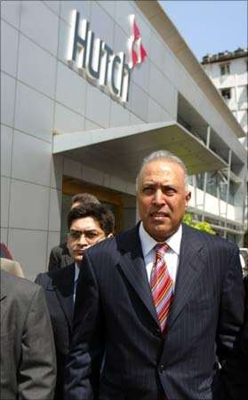
TELECOM sector
11th February 2007
_{○ 2}nd
largest takeover
deal
○ 67 % stake holding in hutch
Image: The then CEO of Vodafone Arun Sarin visits Hutchison Telecommunications head office in Mumbai.

Slide 19
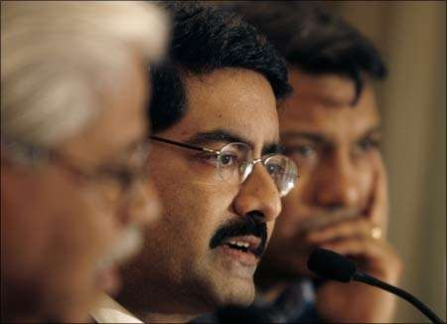
June 2008
Aluminium and copper sector
○ Hindalco Acquired Novelis
Hindalco entered the Fortune-500 listing of world's largest companies by sales revenues
Image: Kumar Mangalam Birla (center), chairman of Aditya Birla Group.

Slide 20
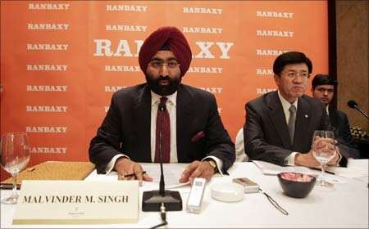
○ Pharmaceuticals sector
June 2008
Acquisition deal
largest-ever deal in the Indian pharma industry
Daiichi Sankyo acquired the majority stake of more than 50 % in Ranbaxy for Rs 15,000 crore
15th biggest drugmaker
Image: Malvinder Singh (left), ex-CEO of Ranbaxy, and Takashi Shoda, president and CEO of Daiichi Sankyo.

Slide 21
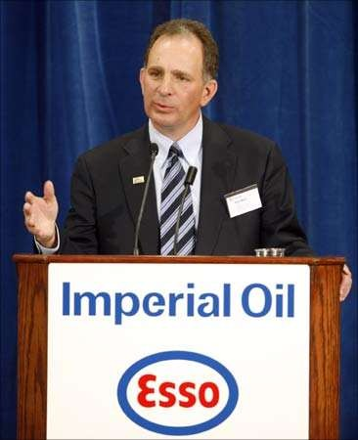
January 2009
Acquisition deal
Imperial energy is a biggest chinese co.
ONGC paid 880 per share to the shareholders of imperial energy
ONGC wanted to tap the siberian market
Image: Imperial Oil
CEO Bruce March.

Slide 22
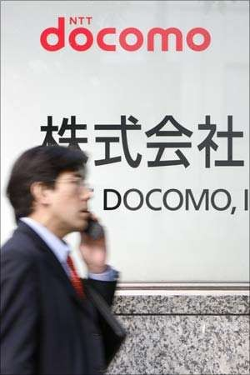
November 2008
Telecom sector
Acquisition deal
Japanese telecom giant NTT DoCoMo acquired 26 per cent equity stake in Tata Teleservices for about Rs 13,070 cr.
Image: A man walks past a signboard of Japan's biggest mobile phone operator NTT Docomo Inc. in Tokyo.

Slide 23
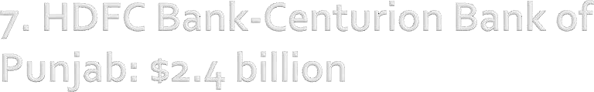
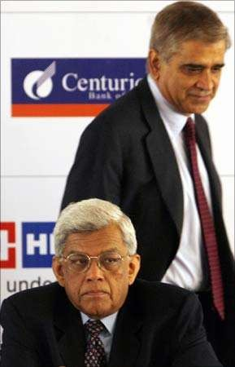
February, 2008
Banking sector
Acquisition deal
CBoP shareholders got one share of HDFC Bank for every 29 shares held by them.
9,510 crore
Image: Rana Talwar (rear) Centurion Bank of Punjab chairman, Deepak Parekh, HDFC Bank chairman.

Slide 24

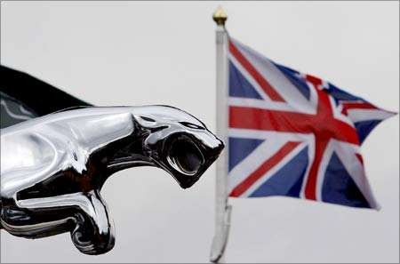
March 2008 (just a year after acquiring Corus)
Automobile sector
Acquisition deal
Gave tuff competition to M&M after signing the deal with ford
Image: A Union flag flies behind a Jaguar car emblem outside a dealership in Manchester, England.

Slide 25
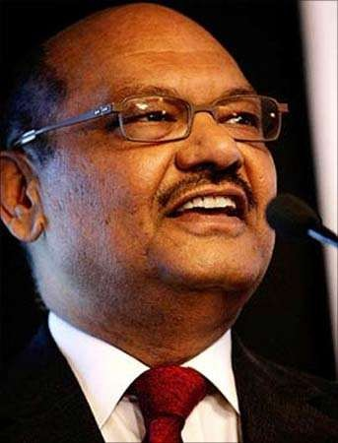
○ May 2008
○ Acquisition deal
○ Sector copper
Image: Vedanta Group chairman
Anil Agarwal.

Slide 26
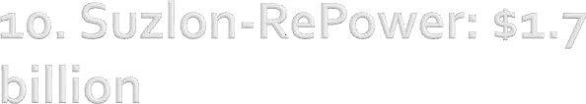
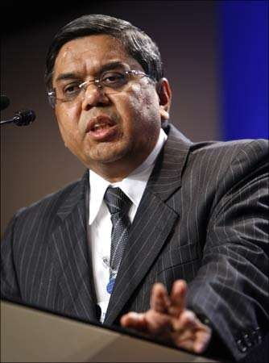
○ May 2007
○ Acquisition deal
Energy sector
Suzlon is now the largest wind turbine maker in Asia
5th largest in the world.
Image: Tulsi Tanti, chairman &
M.D of Suzlon Energy Ltd.

Slide 27
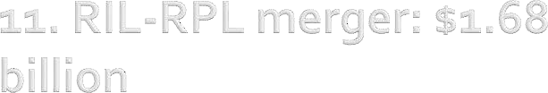
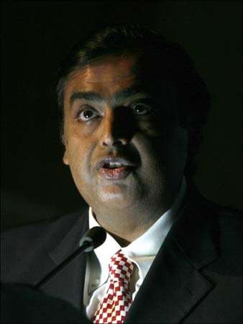
March 2009
Merger deal
amalgamation of its subsidiary Reliance Petroleum with the parent company Reliance industries ltd.
Rs 8,500 crore
RIL-RPL merger swap ratio was at 16:1
Image: Reliance Industries'
chairman Mukesh Ambani.

Slide 28

Dynamic government policies
Corporate investments in industry
Economic stability
“Ready to experiment” attitude of Indian industrialists

Slide 29
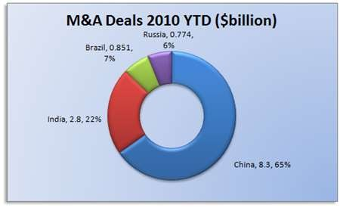

Slide 30
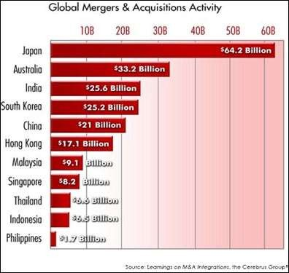

Slide 31
The process of merger and acquisition has the following steps:
Information to the stock exchange
Application in the High Court
Shareholders and Creditors meetings
Sanction by the High Court
Filing of the court order
Transfer of assets or liabilities
Payment by cash and securities
Maximum Waiting period:210 days from the filing of notice(or the order of the commission - whichever earlier).

Slide 32
Cultural Difference
Flawed Intention
No guiding principles
No ground rules
No detailed investigating
Poor stake holder outreach

Slide 33
○ Continuous communication – employees, stakeholders, customers, suppliers and government leaders.
Transparency in managers operations
Capacity to meet new culture higher management professionals must be ready to greet a new or modified culture.
Talent management by the management

Slide 34
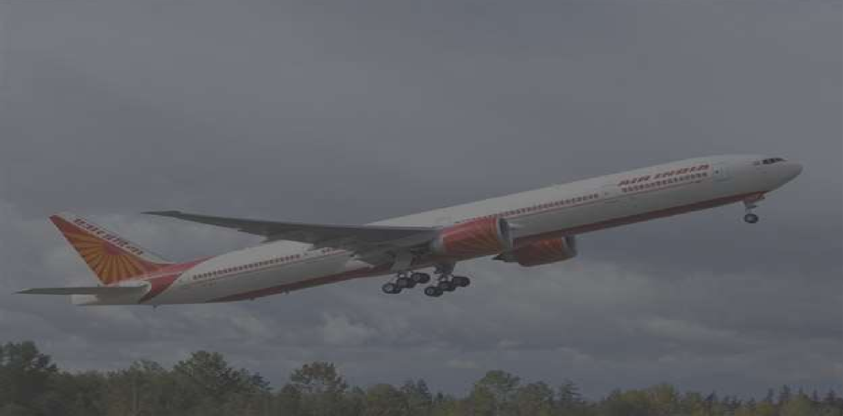


The government of India on 1 march 2007 approved the merger of Air India and Indian airlines.
Consequent to the above a new company called National Aviation Company of India limited was incorporated under the companies act 1956 on 30 march 2007 with its registered office at New Delhi.

Slide 35
Create the largest airline in India and comparable to other airlines in Asia.
Provide an Integrated international/ domestic footprint which will significantly enhance customer proposition and allow easy entry into one of the three global airline alliances, mostly Star Alliance with global consortium of 21 airlines.
Enable optimal utilization of existing resources through improvement in load
factors and yields on commonly serviced routes as well as deploy ‘freed up’ aircraft capacity on alternate routes.
The merger had created a mega company with combined revenue of Rs 150 billion ($3.7billion) and an estimated fleet size of 150. It had a diverse mix of aircraft for short and long haul resulting in better fleet utilization.
Provide an opportunity to fully leverage strong assets, capabilities and infrastructure.
Provide an opportunity to leverage skilled and experienced manpower available
with both the Transferor Companies to the optimum potential.
Provide a larger and growth oriented company for the people and the same shall be in larger public interest.

Slide 36
Potential to launch high growth & profitability businesses (Ground Handling Services, Maintenance Repair and Overhaul etc.)
Provide maximum flexibility to achieve financial and capital restructuring through
revaluation of assets.
Economies of scale enabled routes rationalization and elimination of route duplication. This resulted in a saving of Rs1.86 billion, ($0.04 billion) and the new airlines will be offering more competitive fares, flying seven different types of aircraft and thus being more versatile and utilizing assets like real estate, human resources and aircraft better. However the merger had also brought close to $10 billion (Rs 440 billion) of debt.
The new entity was in a better position to bargain while buying fuel, spares and other materials. There were also major operational benefits.
Traffic rights - The protectionism enjoyed by the national carriers with regard to the traffic right entitlements is likely to continue even after the merger. This will ensure that the merged Airlines will have enough scope for continued expansion, necessitated due to their combined fleet strength.

Slide 37
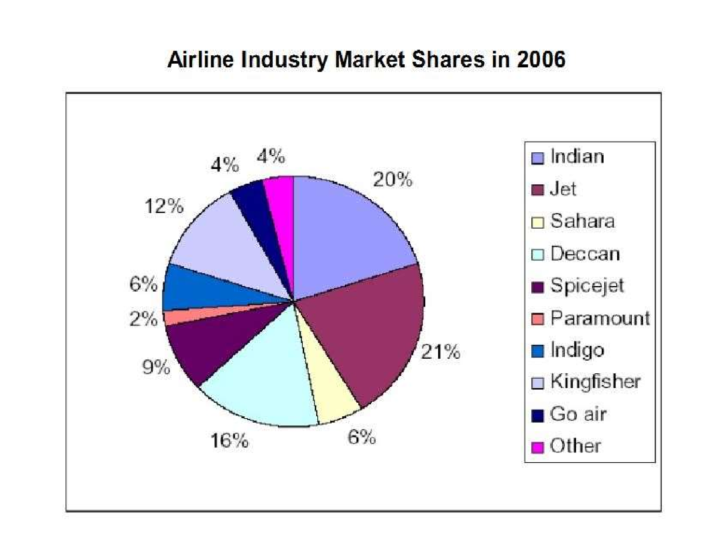

Slide 38
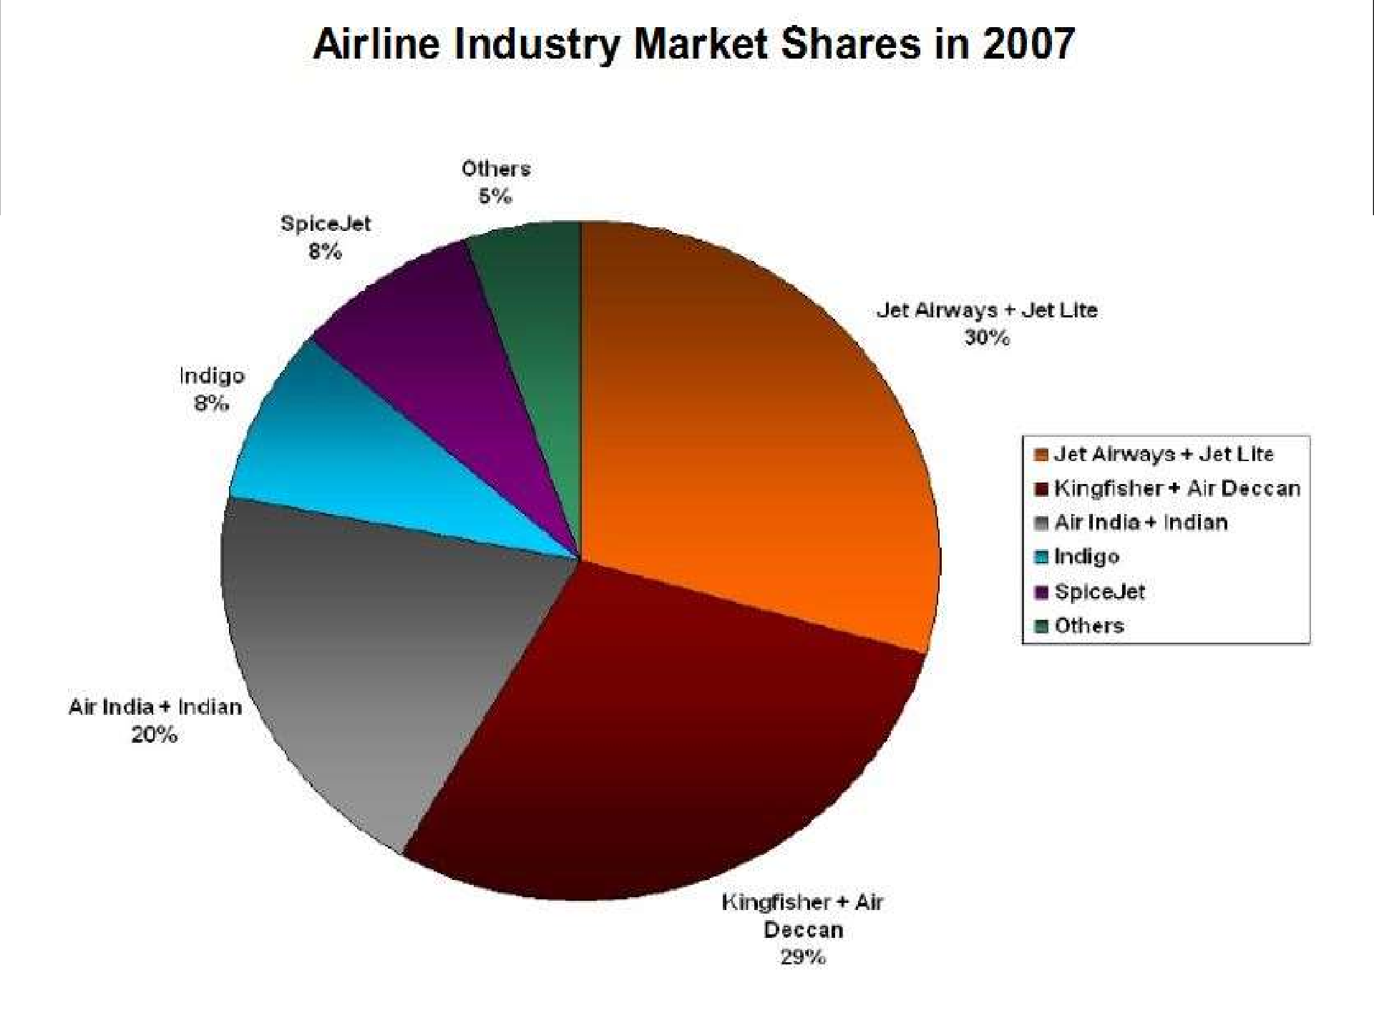
39

Slide 39
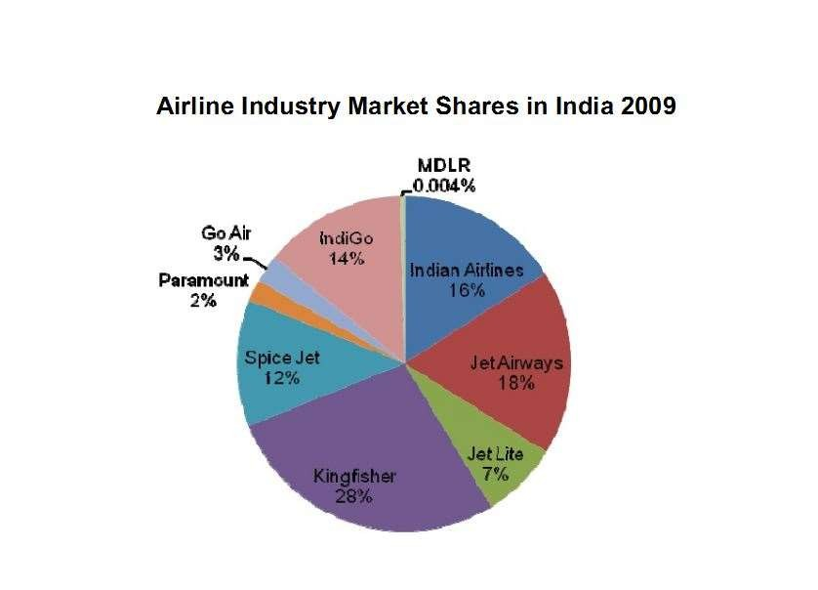
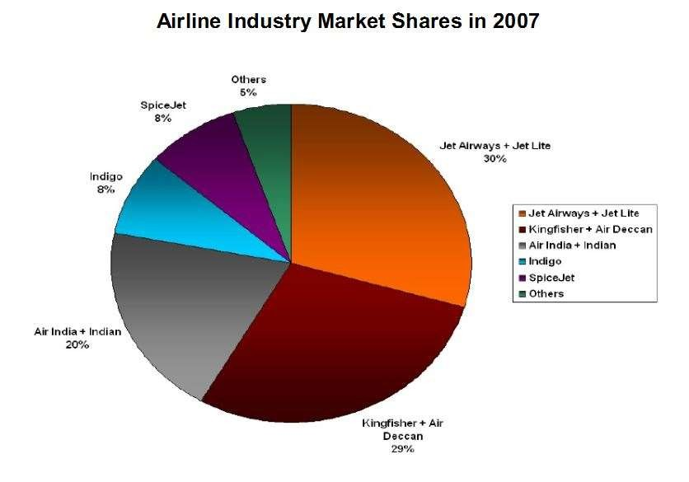
40

Slide 40
The merger coincided with a flurry of increased domestic and international competition.
Weak management and organization structure.
More attention to non-core issues such as long term fleet acquisitions and establishing subsidiaries for ground handling and maintenance, than to addressing the state of the flying business.
Bloated workforce
Unproductive work practices
Political impediments to shedding staff

Slide 41

Learn from mistakes of others
Define your objectives clearly
Complete strategy to achieve goal.
SWOT analysis for the merged business - a must
Conservative attitude necessary at evaluation deskstrong arguments to support project
Pick holes in strategy to get the best
Will merged units be able to work at efficient / ideal level?
Acquire expertise to interpret changes

Slide 42
Thank you for your patience…

